Slide 1
Capacity Building – Integrating Mental Health into Primary Care
Dr Pamela Smith

Slide 2
Mental Health Capacity Building
Definition = development of resources necessary to provide mental health care within a given setting or community
Function = to increase access to mental health care
Means for building MH capacity = integrating mental health care into primary care settings

Slide 3
Primary Care
Definition: health care at a basic rather than specialized level for people making an initial approach to a doctor or nurse for treatment.
General practitioners (GPs); family doctors; nurses, midwives

Slide 4
Reasons Why Integrating MH care into
Primary Care Settings Makes Good Sense

Slide 5
1. High Prevalence of MH disorders Worldwide
An estimated 450 million people worldwide are affected by mental disorders.

Slide 6
2. Mental & physical health issues are inter-related
Global studies indicate:
Depression – associated with diabetes, high blood pressure (hypertension), and cardiac disease (heart attack)
Panic attacks – asthma
Having some type of mental disorder – HIV/AIDS

Slide 7
3. Gap between MH disorders and treatment is large
Gap is significant in all countries
Factors contributing to gap:
Inadequate primary care services for MH
Failure to detect mental conditions (staff w/limited training; patients w/limited awareness of symptoms)
Limited health system financial & human resources
Social stigma, discrimination, misconceptions

Slide 8
4. MH present in primary care setting increases access to care
Convenience - access to MH services closer to home; keeps families together; daily activities can be maintained.
Increases early identification & treatment of conditions
Increased opportunities for family & community education

Slide 9
5. MH in primary care setting facilitates respect of human rights
Closure of outdated institutions – decreased inappropriate, involuntary admissions, inadequate living conditions, & unreported abuses.
Stigma is minimized – MH patients are treated in same manner as other clinic patients

Slide 10
6. MH provided in primary care setting is cost-effective
Inconvenience & cost of lengthy travel - associated people dropping out of treatment
Health workers and equipment are less expensive at primary care level
Cost (i.e. health care budget expenditure) of providing mental health care for 1 person in the primary care setting in low/low-mid income countries < $6

Slide 11
7. MH in primary care setting has been associated with good health outcomes
Global studies indicate anxiety, depression, & etoh abuse have been treated effectively by primary care clinicians

Slide 12
PUSKESMAS

Slide 13
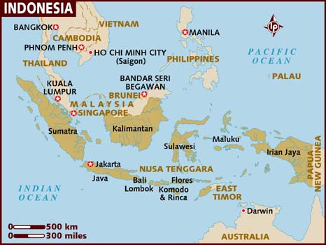
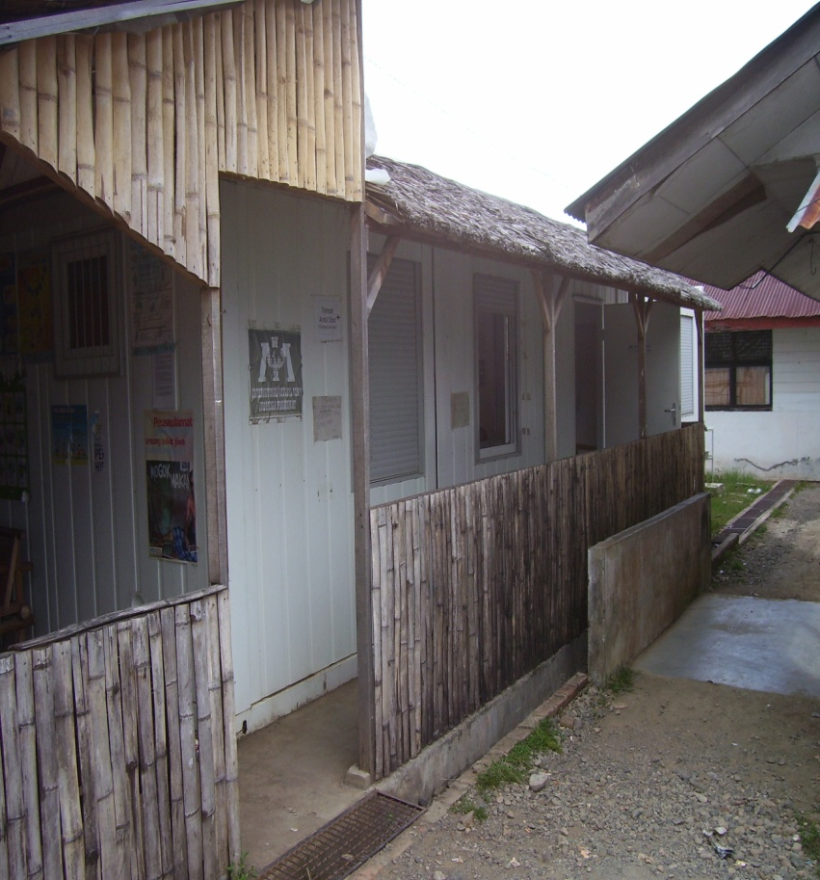
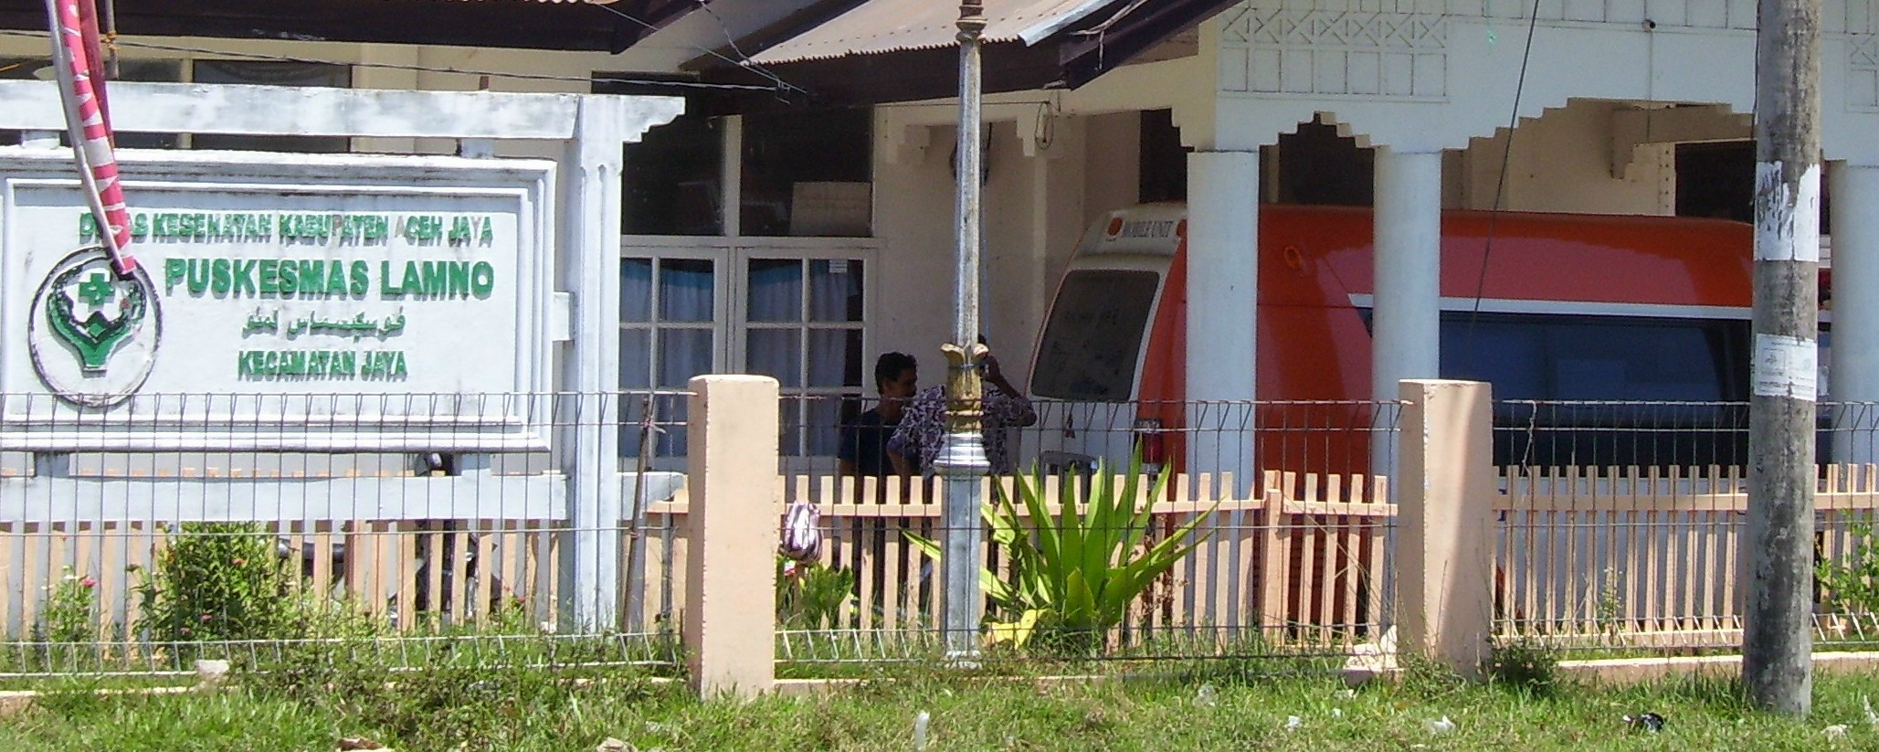

Slide 14
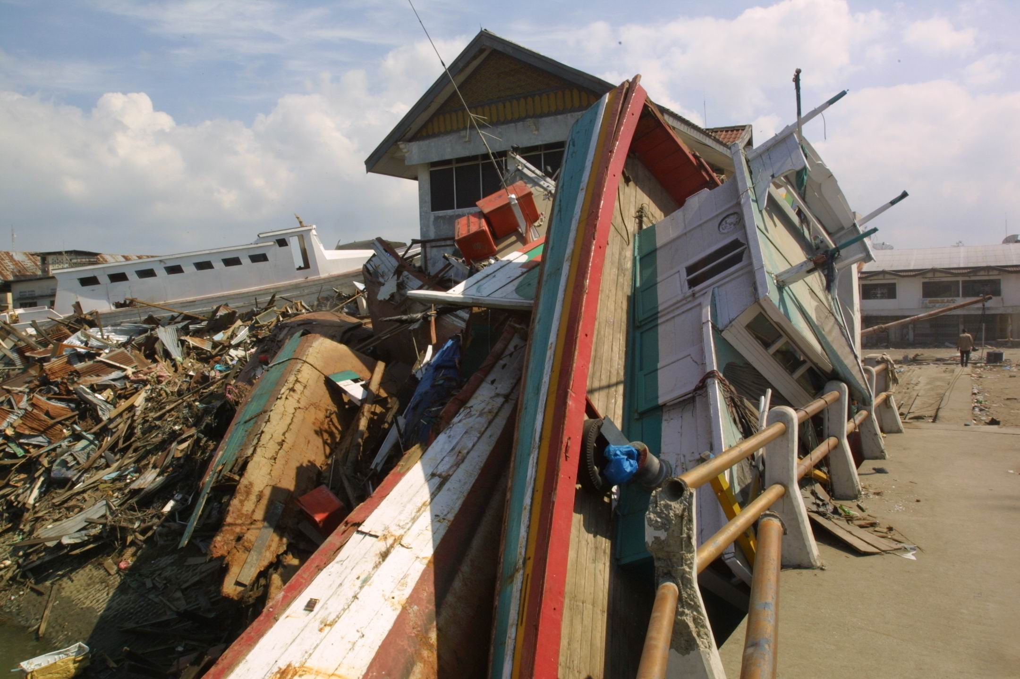

Slide 15
Guiding Principles for Integrating MH into Primary Care Settings

Slide 16
1. Collaboration w/Leaders & Advocacy
In order to provide knowledge and, if necessary, to shift negative attitudes and resistance
Key arguments for MH Supporting in Primary Care:
High prevalence of mental disorders
burden of untreated MH conditions
human rights violations often occurring in psychiatric hospitals
existence of effective primary care-based treatments

Slide 17
2. Revision of policy, plans, & legislation to include mental health as a part of primary care
Formal policy and legislation concretizes commitment to MH in primary care

Slide 18
3. Financial and Human Resources
Financial resources for facilities, specialists (mental health professionals) and additional primary care personnel (if needed) are required to establish and maintain services.

Slide 19
4. Local Mental Health Team
Local team who directs and coordinates development of a MH program (administration, training, care services)
Steers programs around challenges facilitating continuation of the integration process.

Slide 20
5. Adequate training of primary care workers is required
Training primary care workers to identify mental distress and provide basic interventions
Follow-up supervision by mental health specialists

Slide 21
6. Primary care tasks must be limited and doable
Primary care workers tend to function best when their mental health tasks are limited and doable.

Slide 22
7. Local Specialist Mental Health Professionals
If available, local psychologists, social workers, psychiatric nurses, & psychiatrists w/i community facilities and other settings to provide supervision, support, and management of severe situations
Local assistance should always be utilized before seeking outside (expatriate) assistance

Slide 23
8. Essential psychotropic medications must be available
Distribute psychotropic medicines to primary care facilities instead of through psychiatric hospitals.
Revised legislation and regulations to allow primary care workers (e.g. specially trained nurses) to prescribe medications where MH specialists and physicians are scarce.

Slide 24
9. Collaboration w/Community Resources
Village and community health workers – used to identify and refer people to MH care
Community-based nongovernmental organizations (NGO) – programs to improve psychosocial function & decrease need for hospitalization.

Slide 25
10. Integration Takes Time
Lingering skepticism and resistance can take time to overcome.
Major changes in budgets and re-distribution of financial resources can take time
Providing comprehensive MH training to designated health workers is time consuming

Slide 26
Program Models

Slide 27
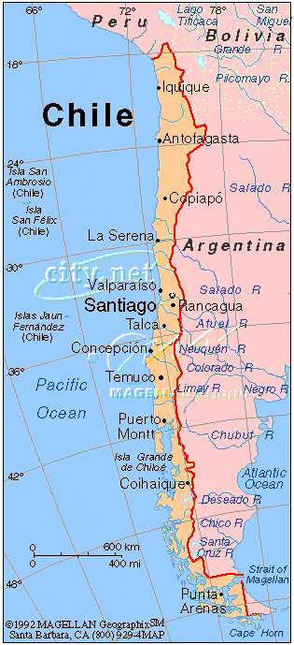

Slide 28
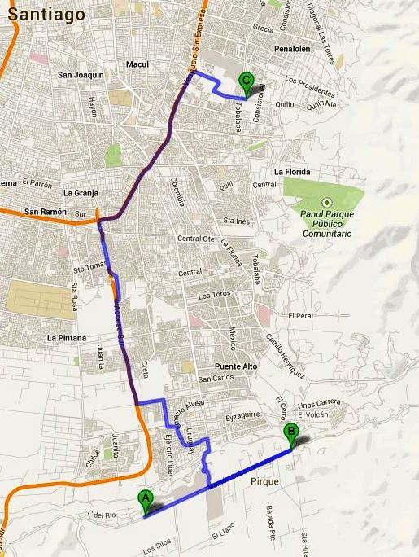

Slide 29
Model 1: Chile: integrated primary care for mental health in the Macul District of Santiago
General physicians (GPs) diagnose mental disorders & prescribe medications where required
Mental health community centre - supervision for GPs; psychologists (individual, family ,group therapy); family health team (support/advocacy)
Health service data= more people with mental disorders have been identified and successfully treated at the MH community centre.

Slide 30
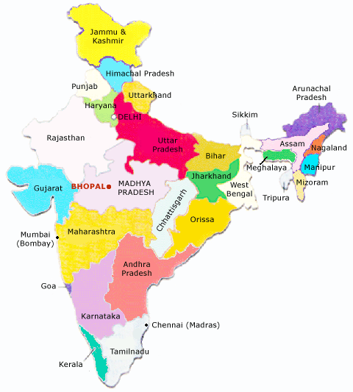
States if India

Slide 31
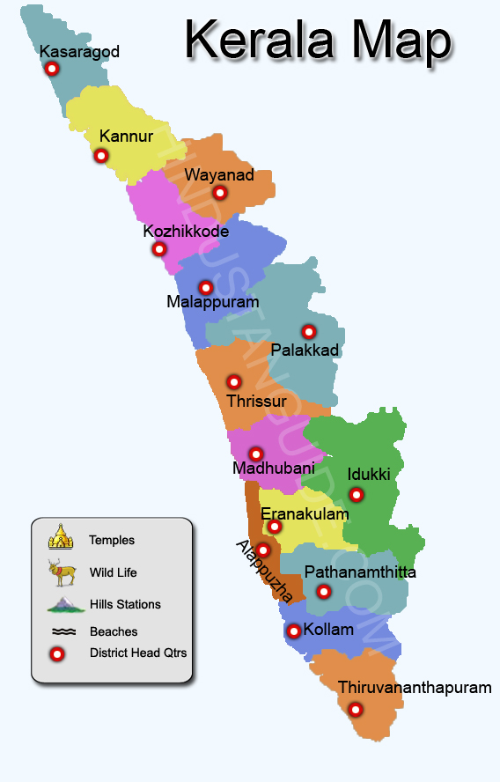

Slide 32
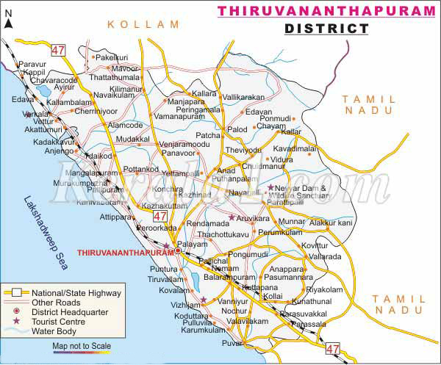

Slide 33
Model 2: India: integrated primary care for mental health in the Thiruvananthapuram District, Kerala State
Trained medical officers w/i primary care centers diagnose and treat mental disorders
District mental health team – psychosocial services; mgmt of complex cases; & training medical officers and other primary care workers.
Primary care centers - evolving; able to provide mental health services independently with minimal district support
MH services in primary care centers – treatment received in communities, reducing expenses and time spent travelling to hospitals.

Slide 34
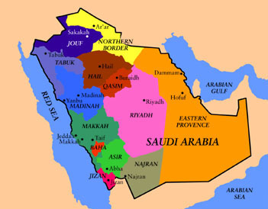

Slide 35
Model 3: Saudi Arabia: integrated primary care for mental health in the Eastern Province
Primary care physicians (PCPs) provide basic mental health services
A community mental health clinics – psychosocial services and training for PCPs
People with mental disorders, who otherwise would have been undetected or hospitalized, are now treated within the community.

Slide 36
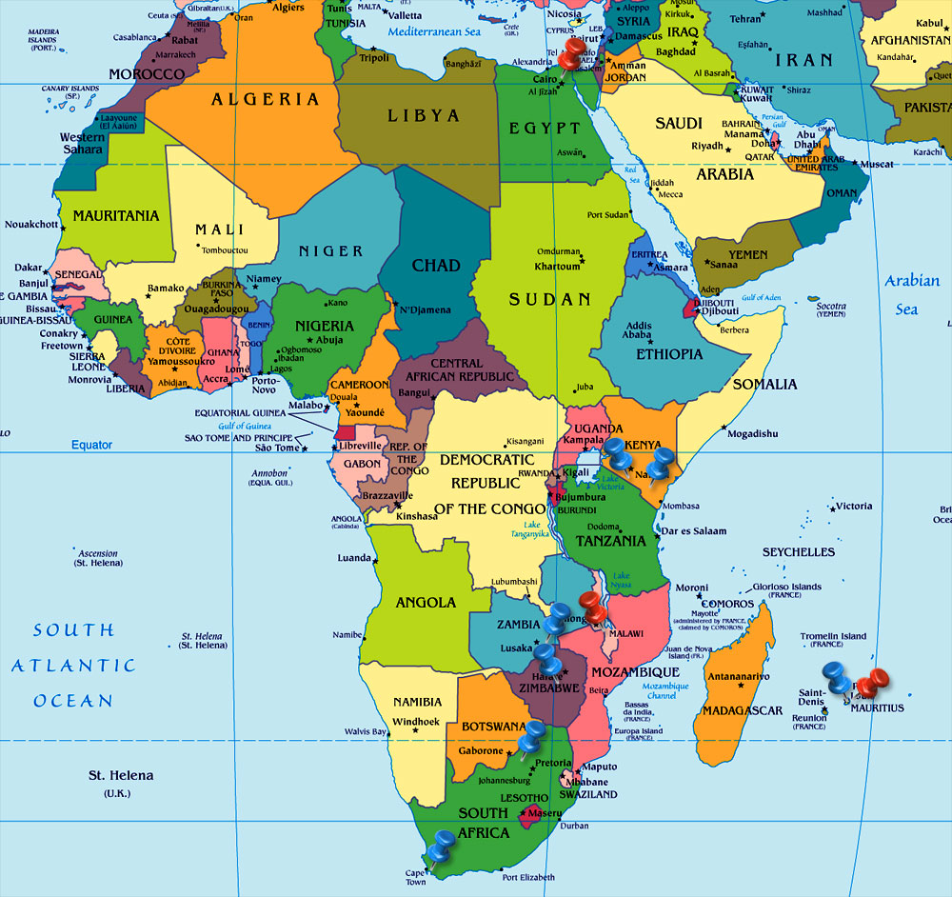

Slide 37
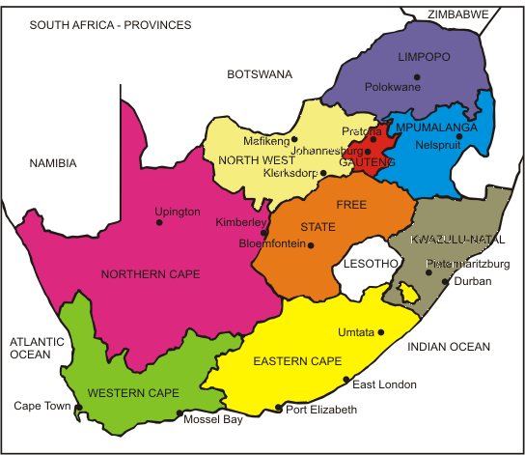

Slide 38
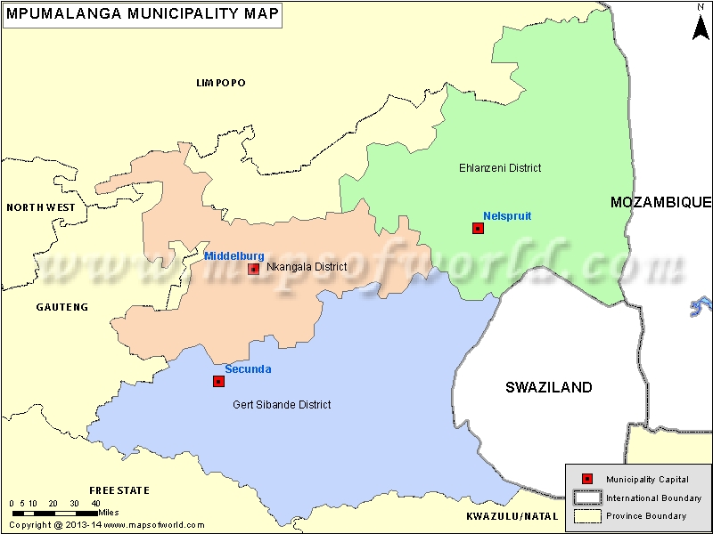

Slide 39
Model 4: South Africa: Integrated primary care services for mental health in the Ehlanzeni District,
Mpumalanga Province
Two distinct service models:
Trained nurse - designated to see all patients with mental disorders within the primary care clinic.
Primary care worker - Mental disorders are managed as any other health problem
Clinics adopt the model that best accommodates their available resources and local needs

